Slide 1
ENERGY CONSUMPTION TIME SERIES
NAME: EDWARD TAN YUAN CHONG

Slide 2
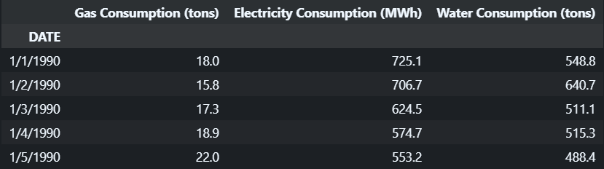
INTRODUCTION
DATASET: energy_consumption.csv
INFORMATION OF DATASET: The dataset includes information of energy consumption, consisting of gas, electricity and water consumption of the first day of every month from 1990 to 2023 Janurary.
TASK: Train a time series model to forecast the gas, electricity and water consumption in the future.

Slide 3
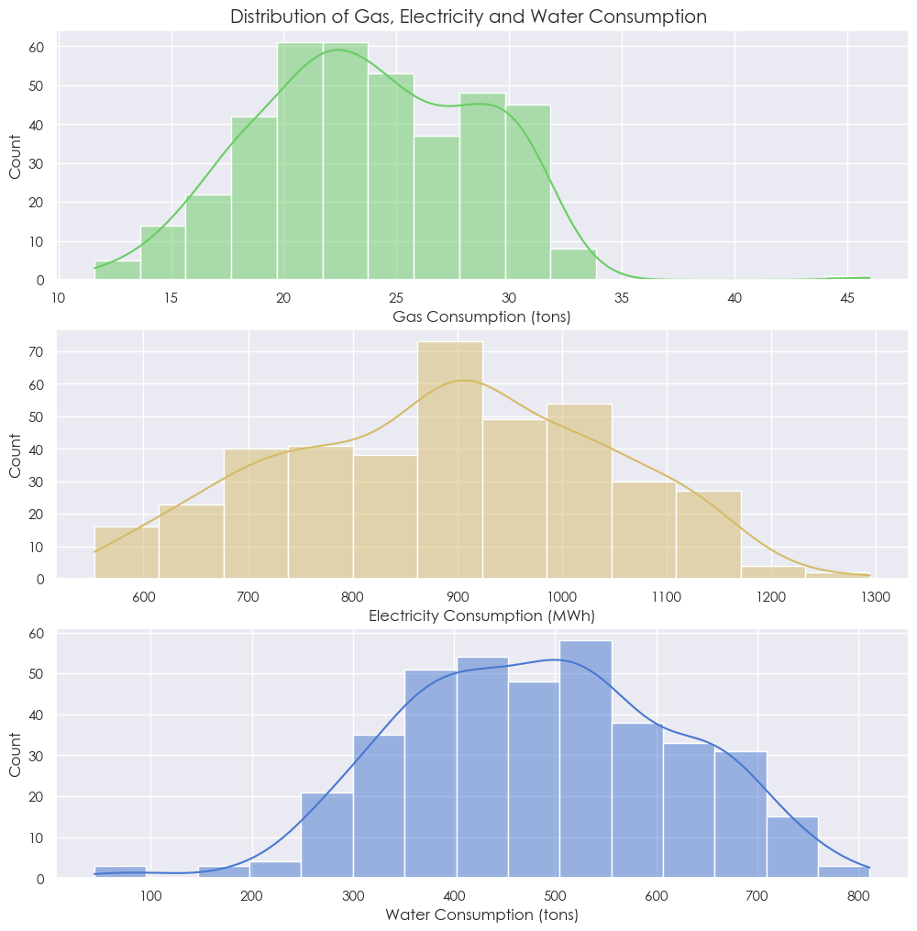
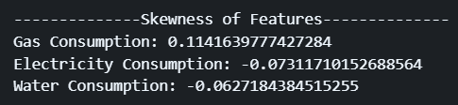
EXPLORATORY DATA ANALYSIS
CHART 1

Slide 4
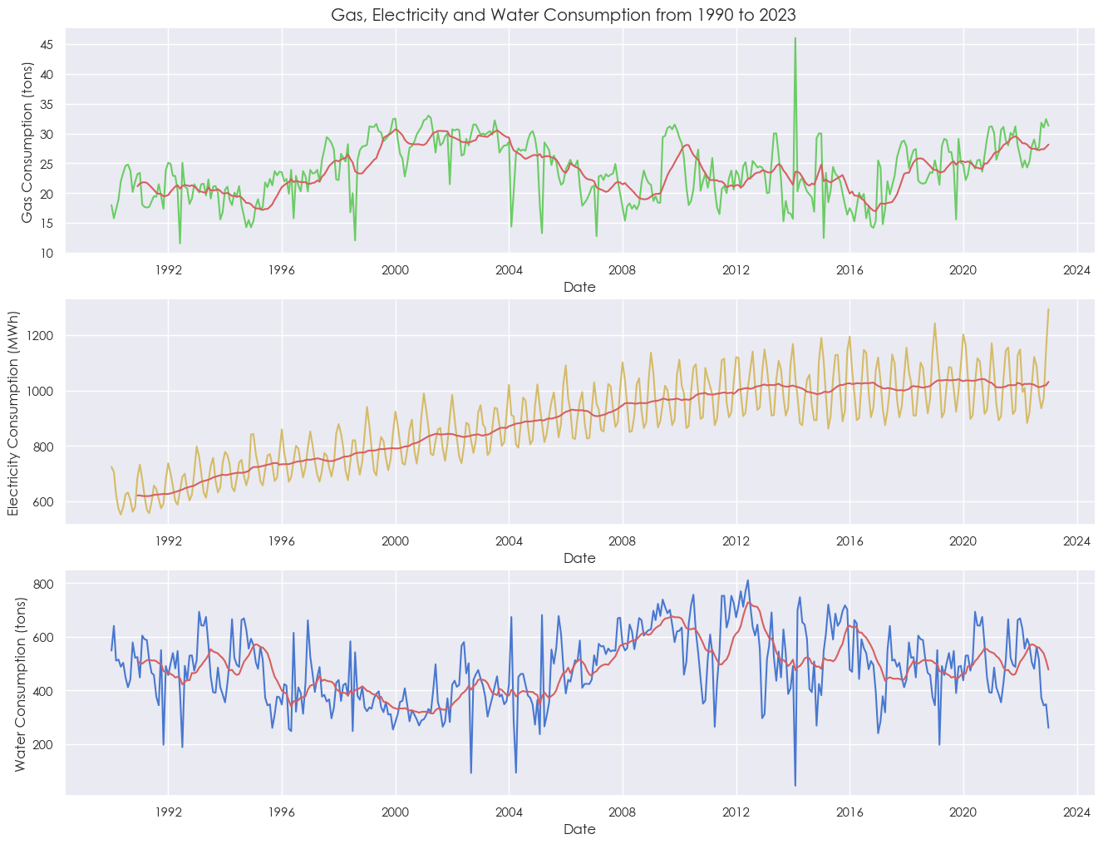
EXPLORATORY DATA ANALYSIS
CHART 2

Slide 5
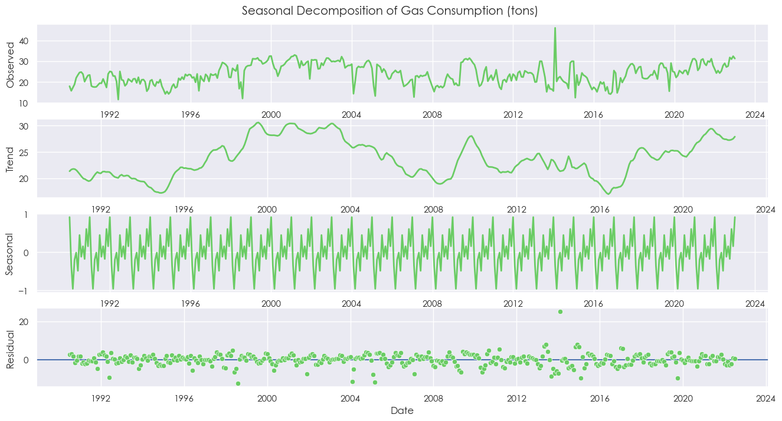
EXPLORATORY DATA ANALYSIS
CHART 3

Slide 6
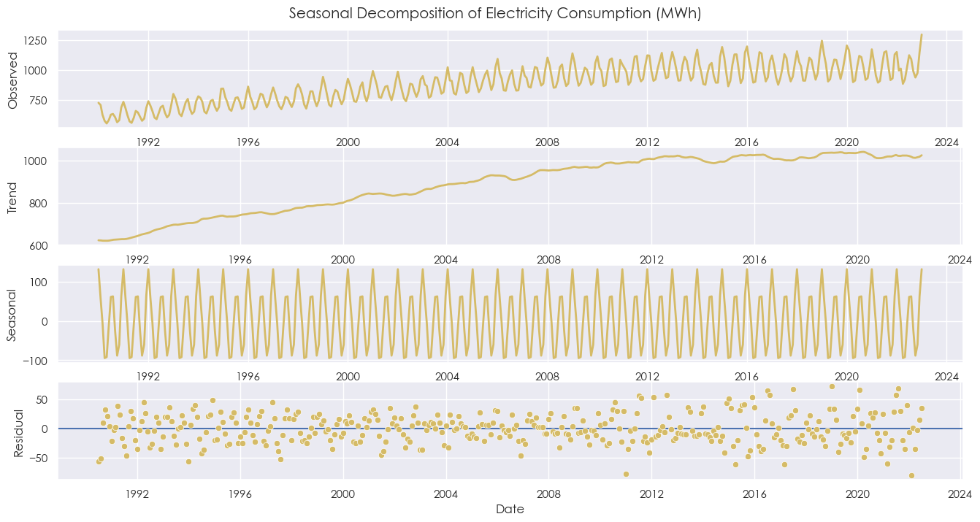
EXPLORATORY DATA ANALYSIS
CHART 4

Slide 7
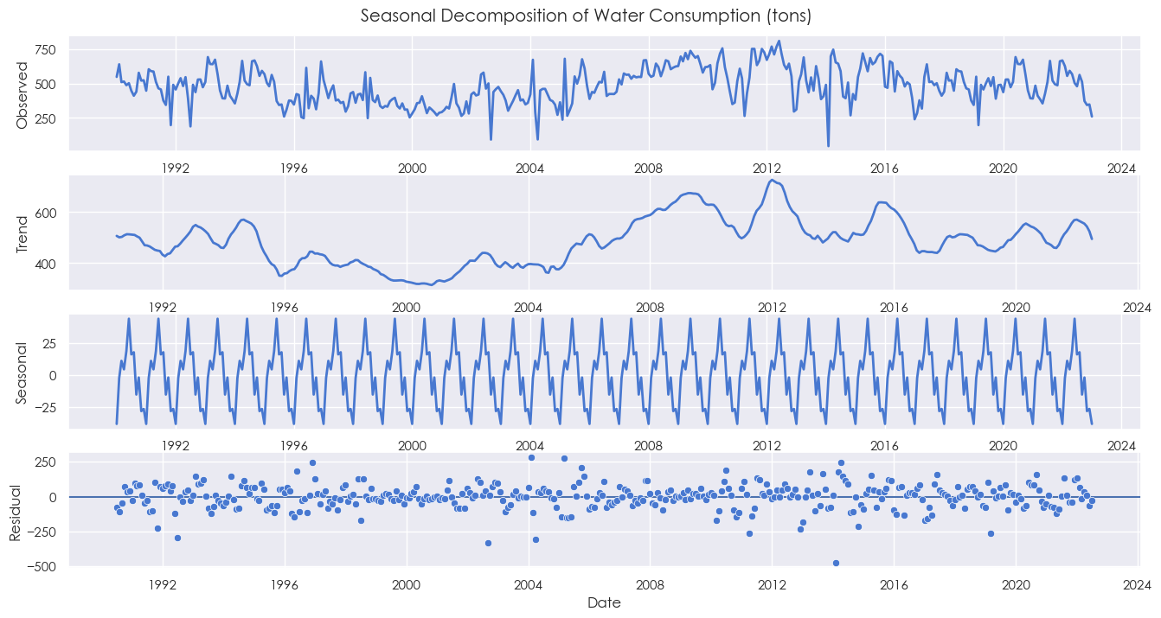
EXPLORATORY DATA ANALYSIS
CHART 5

Slide 8
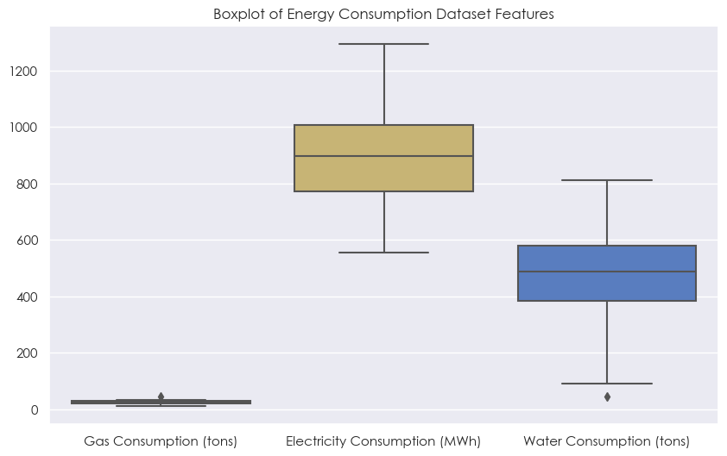
EXPLORATORY DATA ANALYSIS
CHART 6

Slide 9
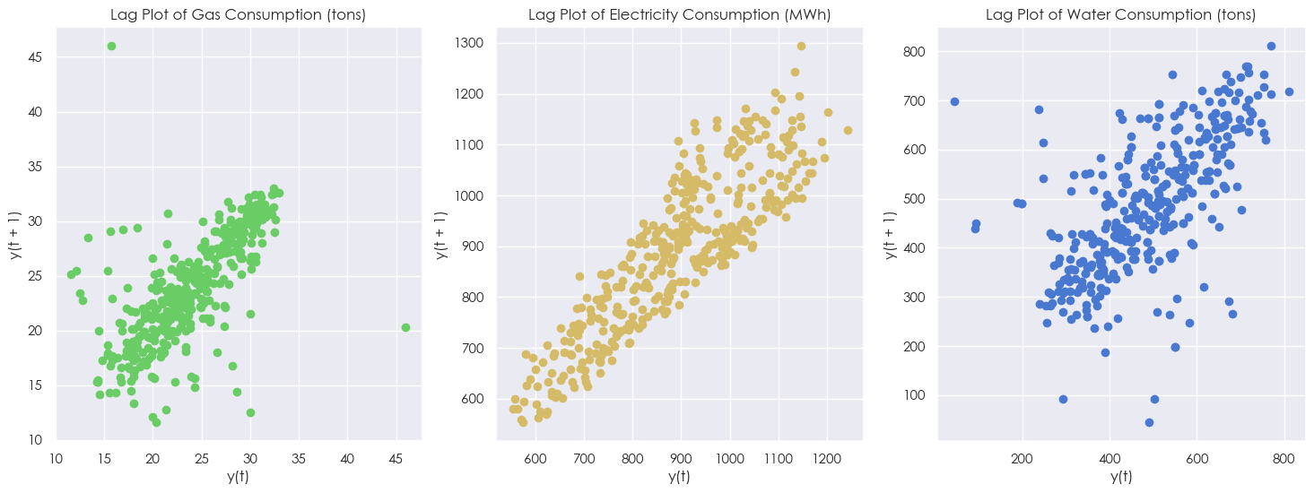
EXPLORATORY DATA ANALYSIS
CHART 7

Slide 10
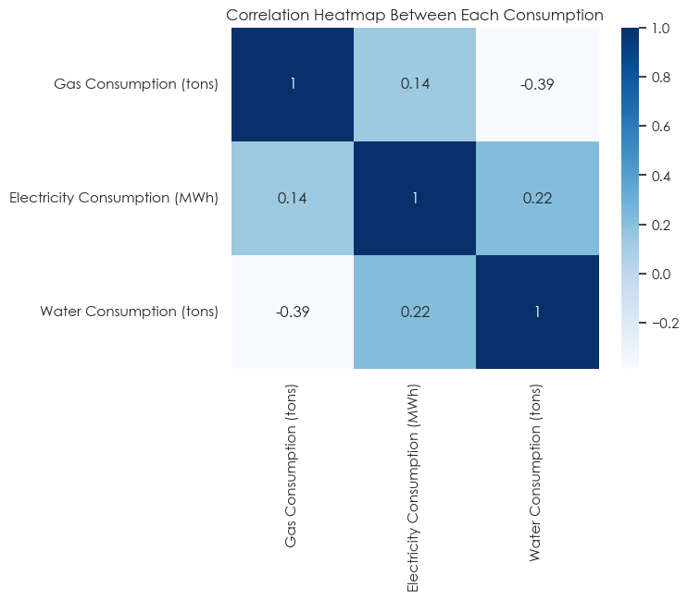
EXPLORATORY DATA ANALYSIS
CHART 8

Slide 11
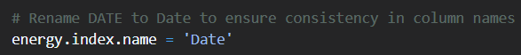
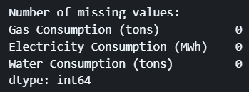
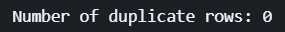
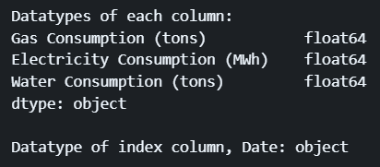
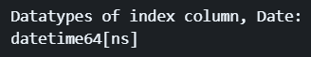
FEATURE ENGINEERING
Rename ‘DATE’ Column
Checking whether data cleaning is required
Datatype of ‘Date’ should be datetime64

Slide 12
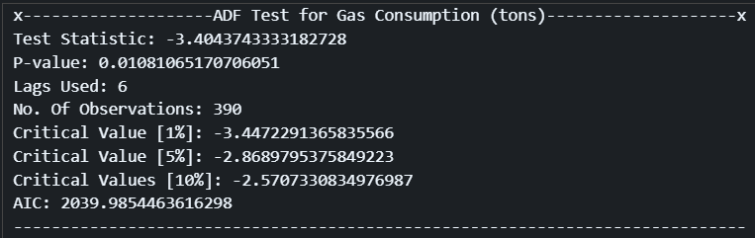

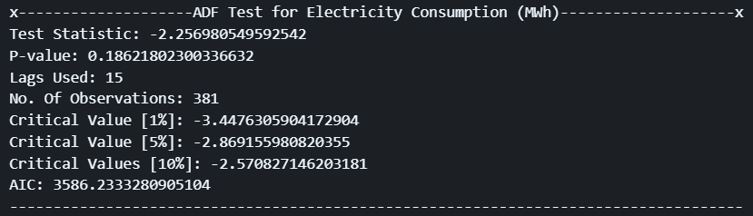
FEATURE ENGINEERING
ADF Test for Gas Consumption
ADF Test for Electricity Consumption
> 0.05 !

Slide 13
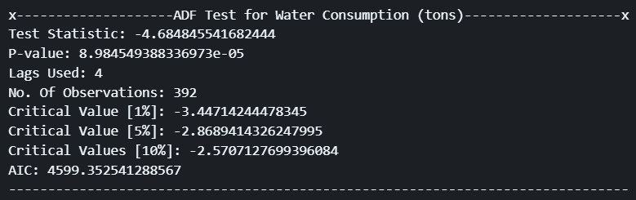
FEATURE ENGINEERING
ADF Test for Water Consumption
Conclusion from ADF Test:
Gas consumption and Water consumption are stationary
Electricity consumption is non-stationary and would require differencing to achieve stationarity

Slide 14
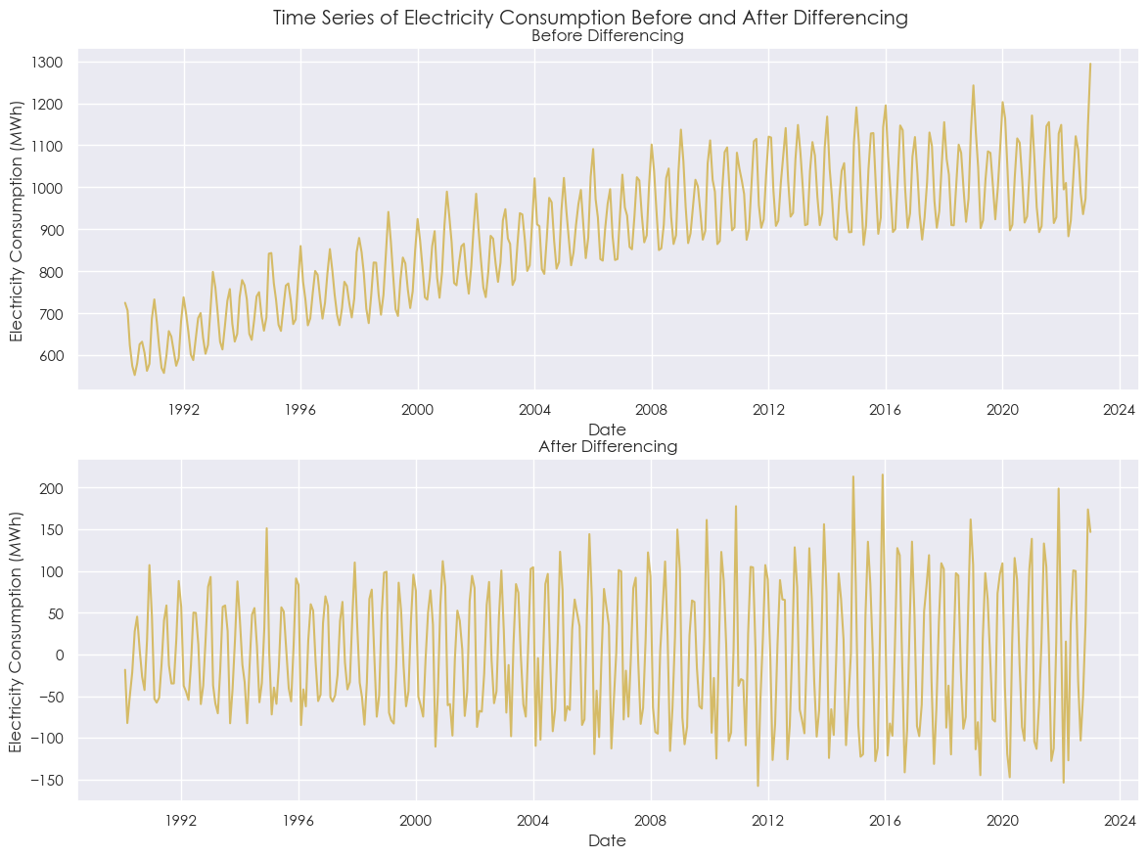
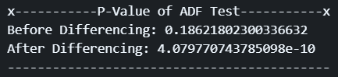
FEATURE ENGINEERING
Differencing for Electricity Consumption

Slide 15
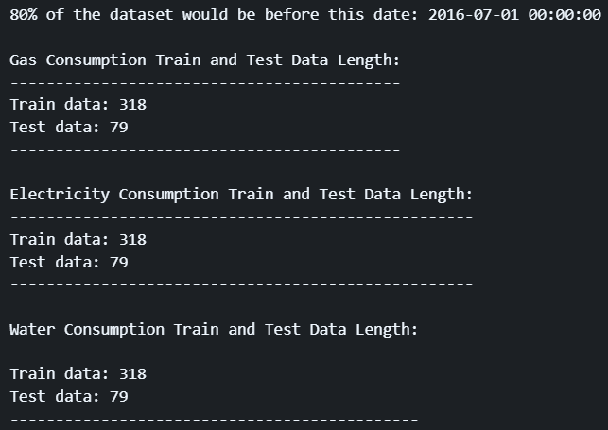
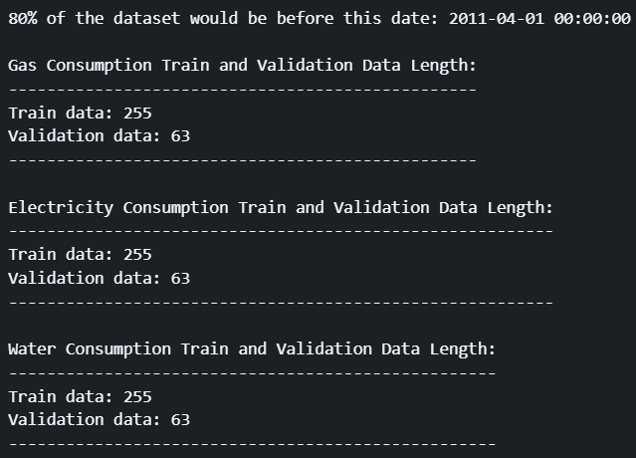
TRAIN VALIDATION TEST SPLIT
Train + Validation and Test Split
Train and Validation Split
Train : Validation : Test
65 : 15 : 20

Slide 16
TIME SERIES MODEL SELECTION
Evaluation Methods:
- Visual Inspection from the 5-fold CV [FOCUS]
- Mean Absolute Error (MAE)
- Mean Absolute Percentage Error (MAPE) [FOCUS]
- Mean Squared Error (MSE)
- Root Mean Squared Error (RMSE)
- R-Squared
- Explained Variance
Time series models tested:
- Holt Winter's Exponential Smoothing
- ARIMA
- SARIMAX
Time series cross-validation was applied hence there is no summary & diagnostic plot for ARIMA and SARIMAX in model selection and instead would be used in final forecast only.

Slide 17

TIME SERIES MODEL SELECTION
One thing to note is that we utilized time series cross-validation as we want to prevent data leakage when using test data to validate.
For time series cross-validation, I used the train + validation dataset instead of just the train dataset to split into k-folds.
Through experimentation, it was noticed that the training dataset itself was likely too small, which resulted in Exponential Smoothing performing the best across all types of consumptions.

Slide 18
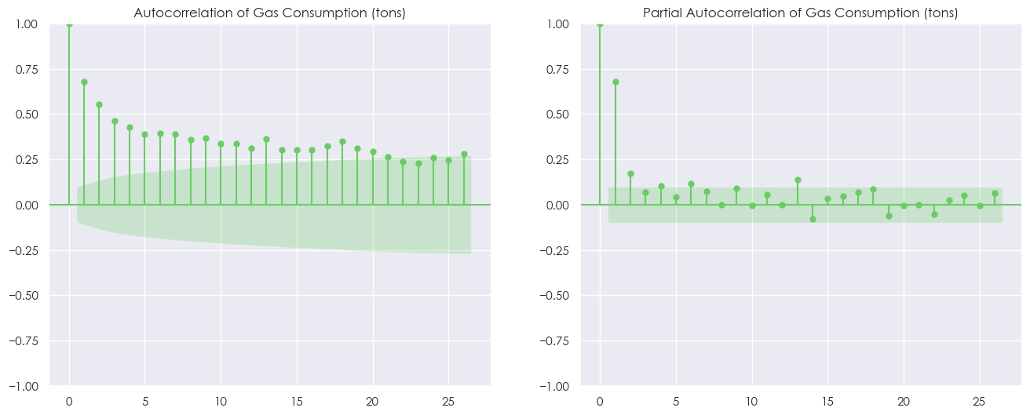
TIME SERIES MODEL SELECTION
GAS CONSUMPTION
p , d , q
ORDER = (2,0,0)

Slide 19
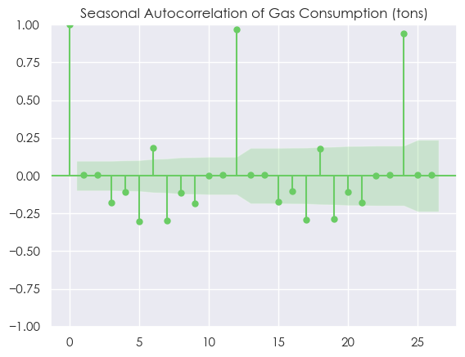
TIME SERIES MODEL SELECTION
GAS CONSUMPTION
Seasonality trend = yearly -> m=12

Slide 20
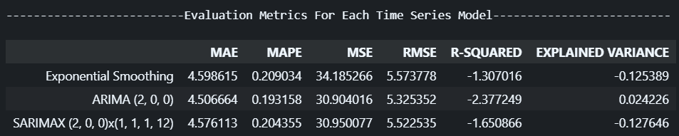
TIME SERIES MODEL SELECTION
GAS CONSUMPTION

Slide 21
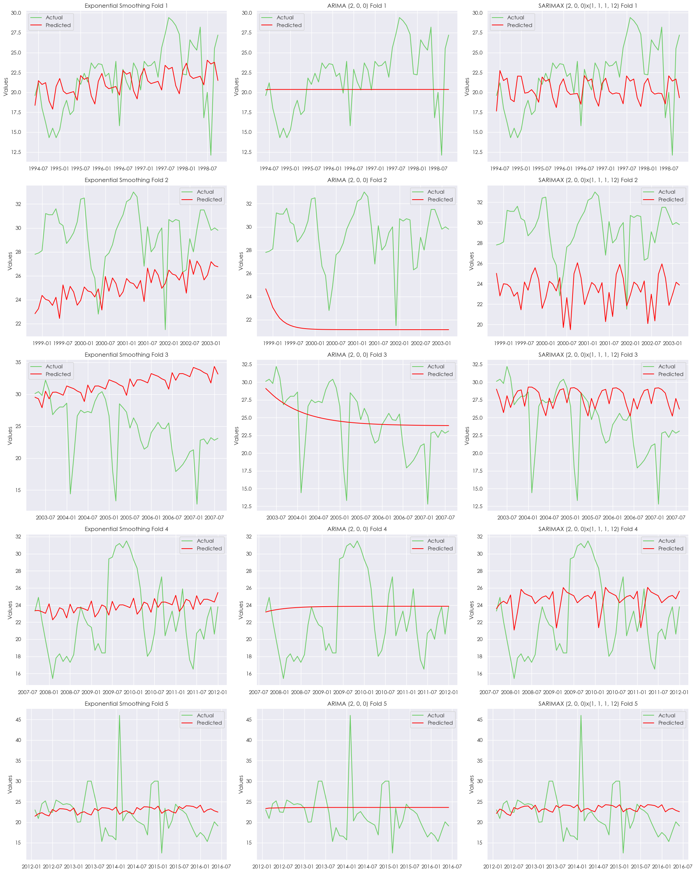

Slide 22

TIME SERIES MODEL SELECTION
GAS CONSUMPTION
FINAL TIME SERIES MODEL FOR GAS CONSUMPTION (TONS): SARIMAX

Slide 23
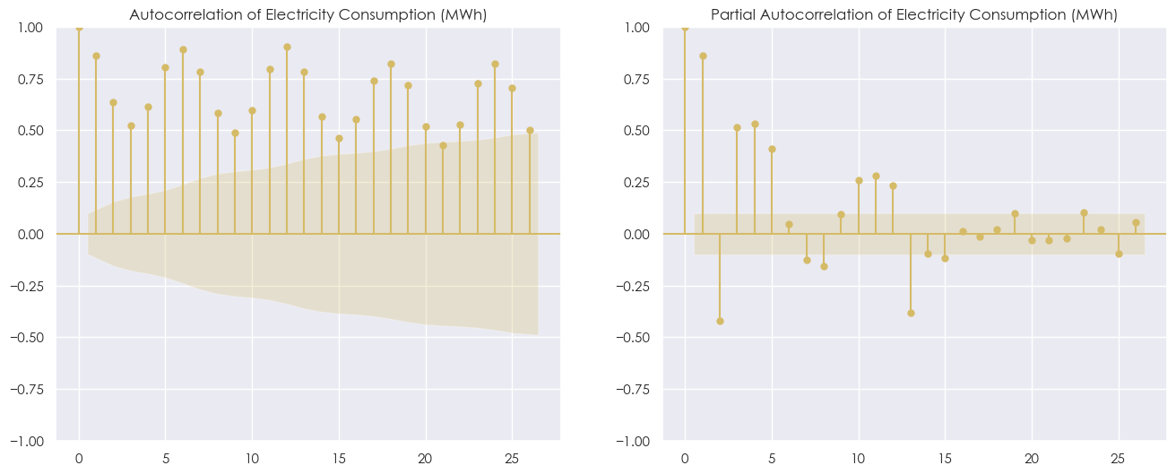
TIME SERIES MODEL SELECTION
ELECTRICITY CONSUMPTION
Inconclusive => Hyperparameter tuning required

Slide 24
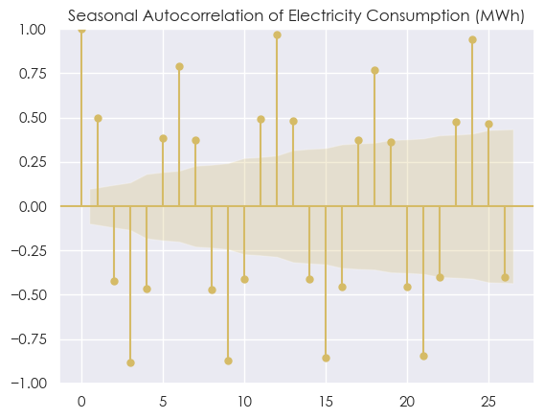
TIME SERIES MODEL SELECTION
ELECTRICITY CONSUMPTION
Seasonality trend = yearly -> m=12

Slide 25
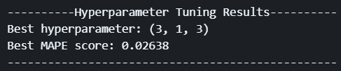
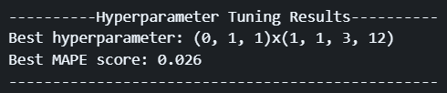
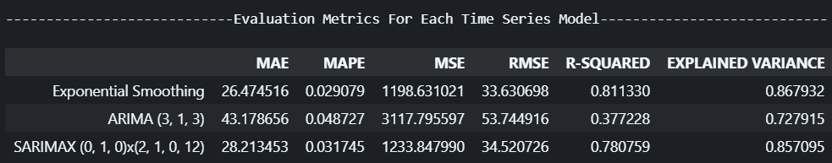
TIME SERIES MODEL SELECTION
ELECTRICITY CONSUMPTION
ARIMA
SARIMAX

Slide 26
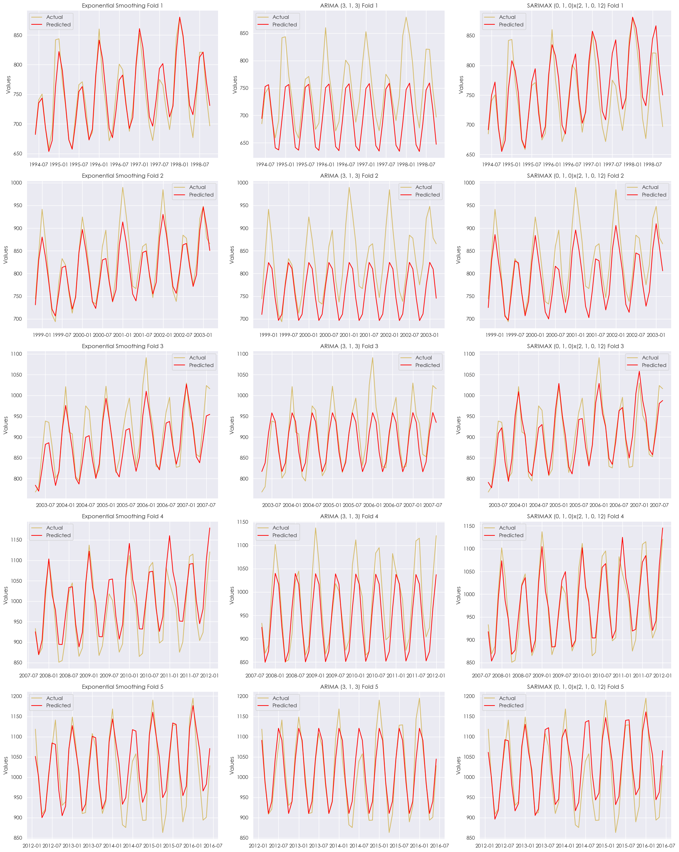
FINAL TIME SERIES MODEL FOR ELECTRICITY CONSUMPTION (MWH): EXPONENTIAL SMOOTHING

Slide 27
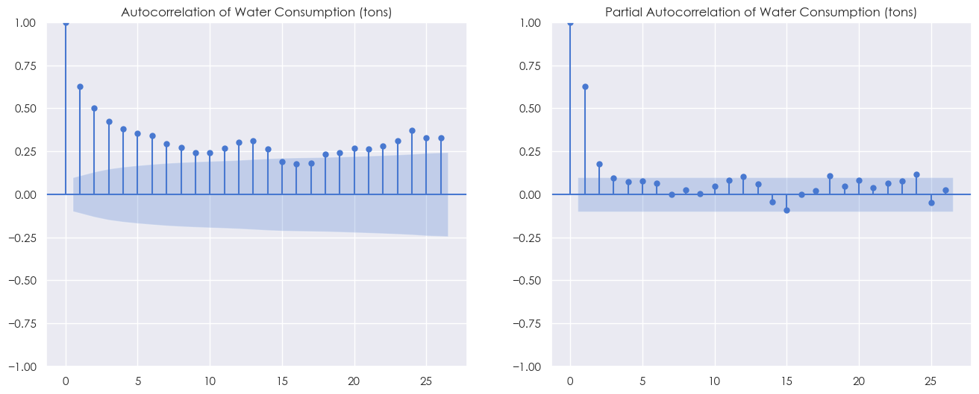
TIME SERIES MODEL SELECTION
WATER CONSUMPTION
p , d , q
ORDER = (2,0,0)

Slide 28
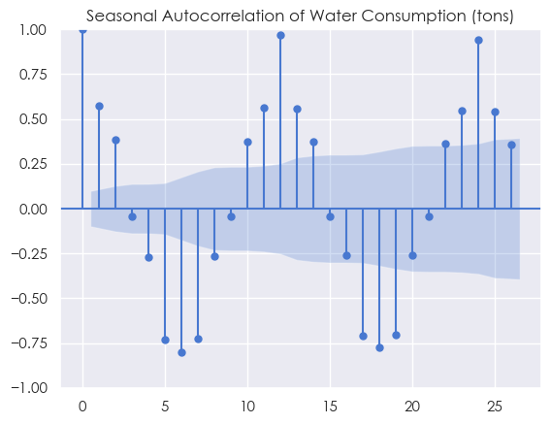
TIME SERIES MODEL SELECTION
WATER CONSUMPTION
Seasonality trend = yearly -> m=12

Slide 29
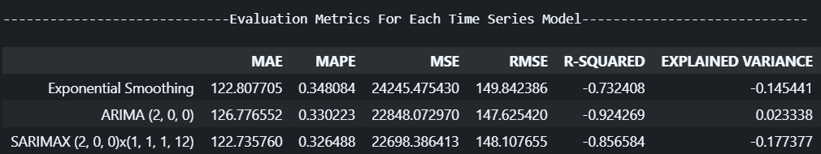
TIME SERIES MODEL SELECTION
WATER CONSUMPTION

Slide 30
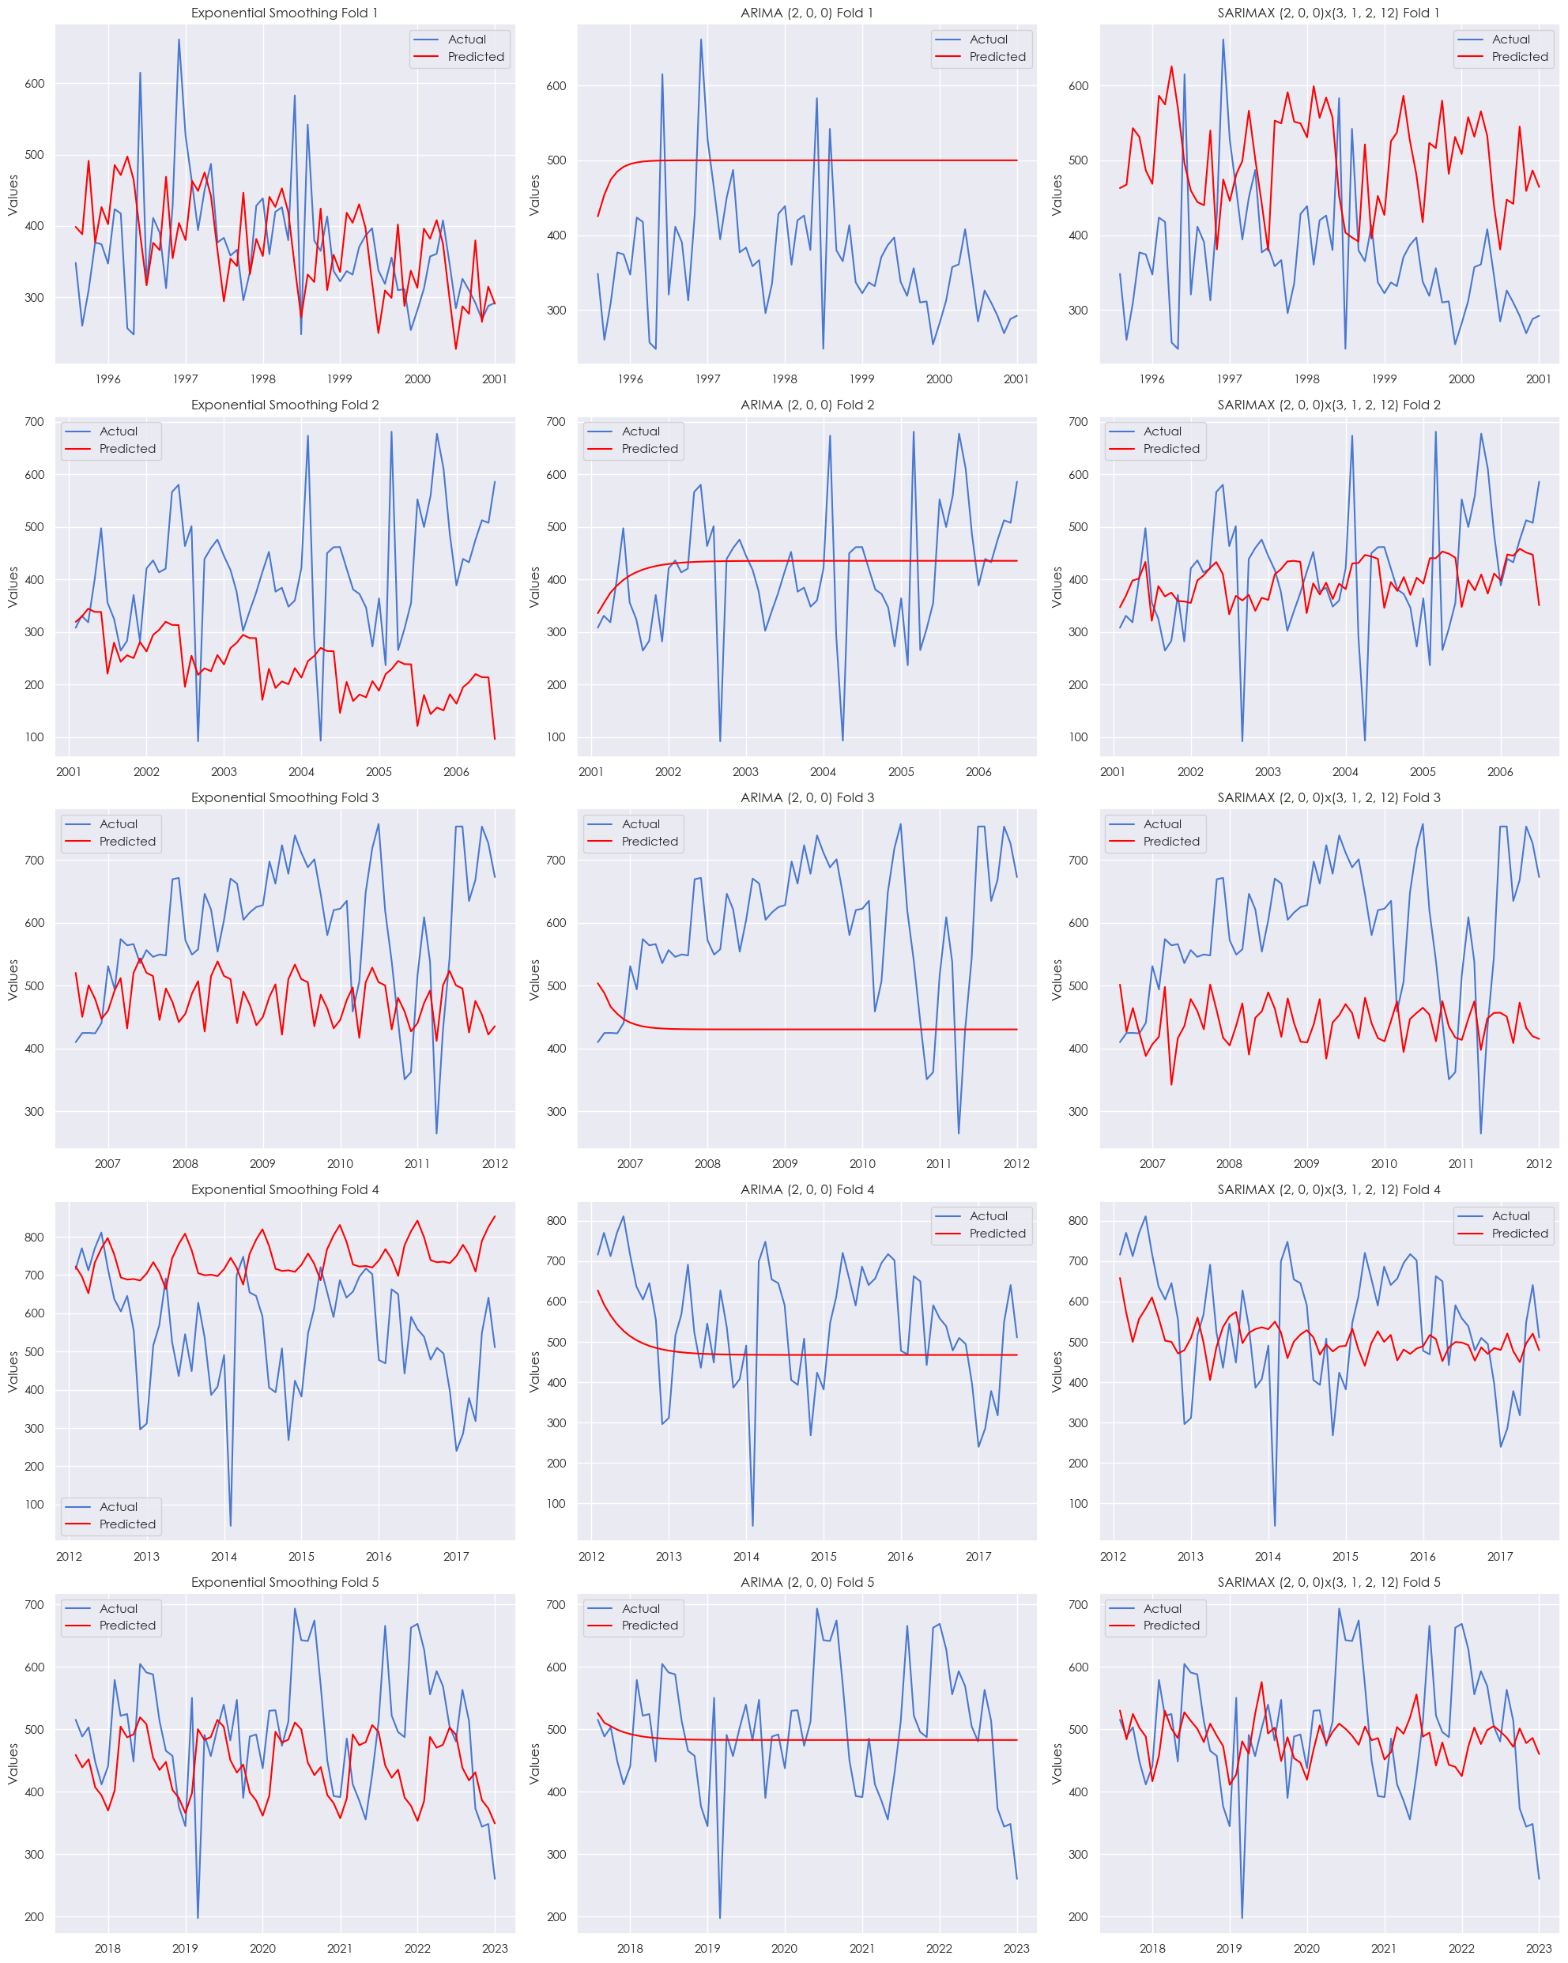

Slide 31
TIME SERIES MODEL SELECTION
WATER CONSUMPTION
FINAL TIME SERIES MODEL FOR WATER CONSUMPTION (TONS): SARIMAX

Slide 32
TIME SERIES MODEL SELECTION
FINAL TIME SERIES MODEL FOR GAS CONSUMPTION (TONS): SARIMAX
FINAL TIME SERIES MODEL FOR ELECTRICITY CONSUMPTION (MWH): EXPONENTIAL SMOOTHING
FINAL TIME SERIES MODEL FOR WATER CONSUMPTION (TONS): SARIMAX

Slide 33
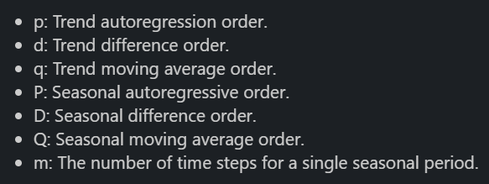
HYPERPARAMETER TUNING
SARIMAX
EXPONENTIAL SMOOTHING
WATER CONSUMPTION
ELECTRICITY CONSUMPTION
GAS CONSUMPTION
order (p,d,q) , seasonal_order (P,D,Q,m)
- trend
damped_trend
- seasonal
seasonal_periods
- freq
- use_boxcox

Slide 34
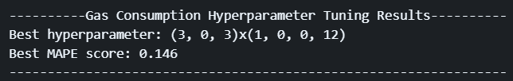
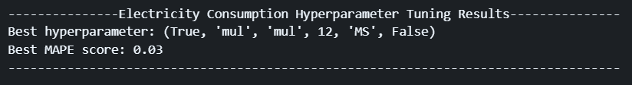
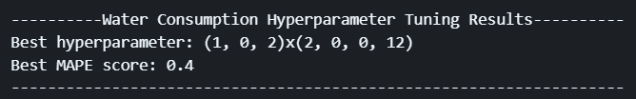
HYPERPARAMETER TUNING
GAS CONSUMPTION
ELECTRICITY CONSUMPTION
WATER CONSUMPTION

Slide 35
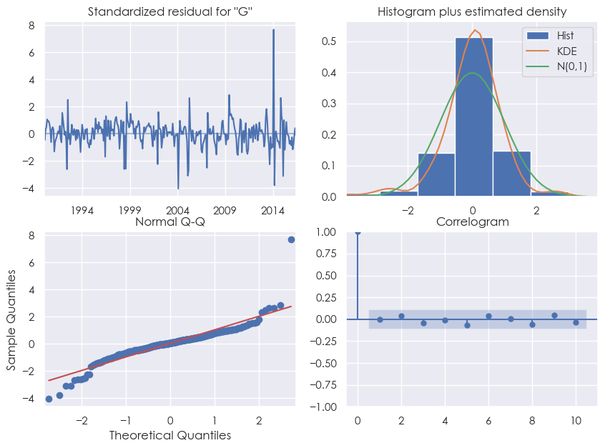
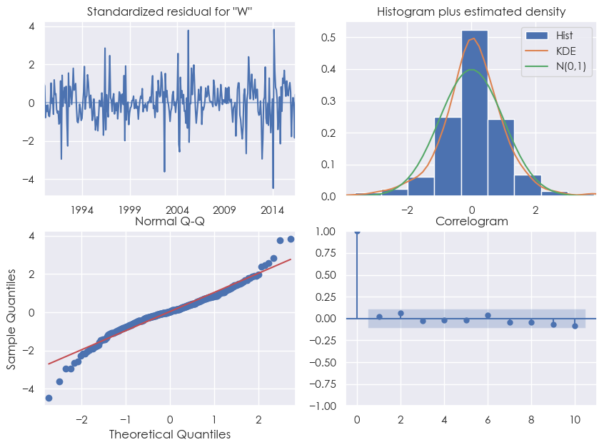
TIME SERIES FORECASTING
SARIMAX DIAGNOSTIC PLOTS
GAS CONSUMPTION
WATER CONSUMPTION

Slide 36
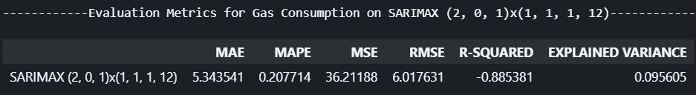
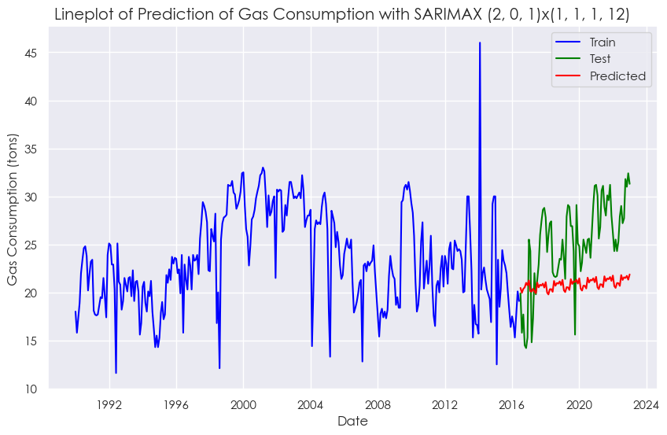
TIME SERIES FORECASTING
GAS CONSUMPTION
REQUIRES FINE-TUNING!

Slide 37
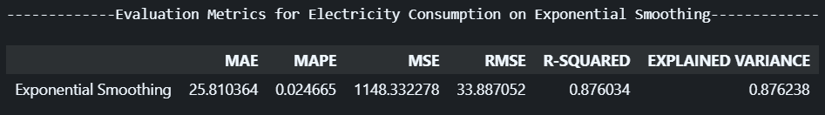
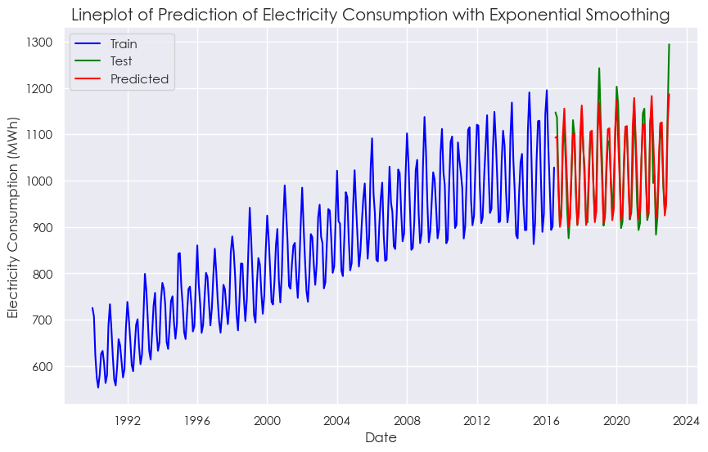
TIME SERIES FORECASTING
ELECTRICITY CONSUMPTION
PERFORMED WELL!

Slide 38
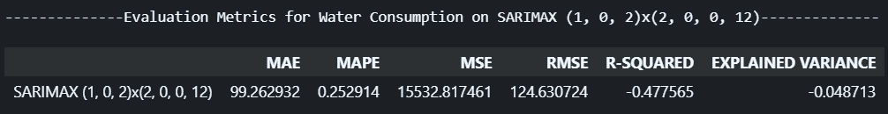
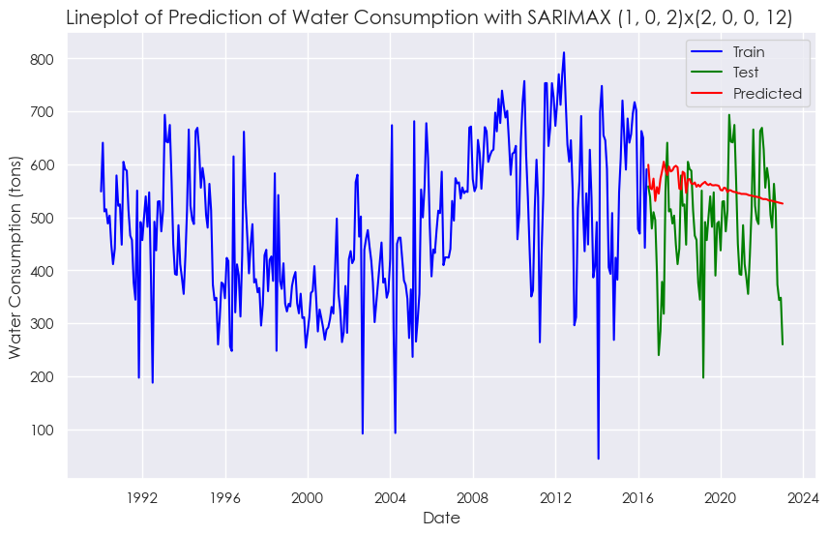
TIME SERIES FORECASTING
WATER CONSUMPTION
REQUIRES FINE-TUNING!

Slide 39
TIME SERIES FORECASTING
FINE TUNING
From the final models, the MAPE scores for Gas and Water consumption still seemed rather high, and I was not satisfied with the results, hence I attempted to fine-tune models manually in order to try to improve their predictions. I tried to fine-tune the hyperparameters with values that were not tested during hyperparameter tuning as by including so many values, it would become too computationally expensive and take very long to run each hyperparameter tuning.
One thing to note here is that the test data that the forecasts made here were compared to maybe overfitted and lead to overly optimistic results, and hence these fine-tuned models should be further tested on new unseen data if possible before actually being fully deployed to the real world.

Slide 40
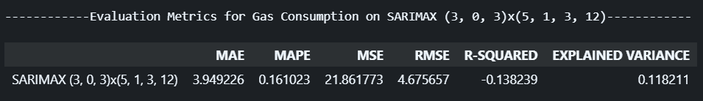
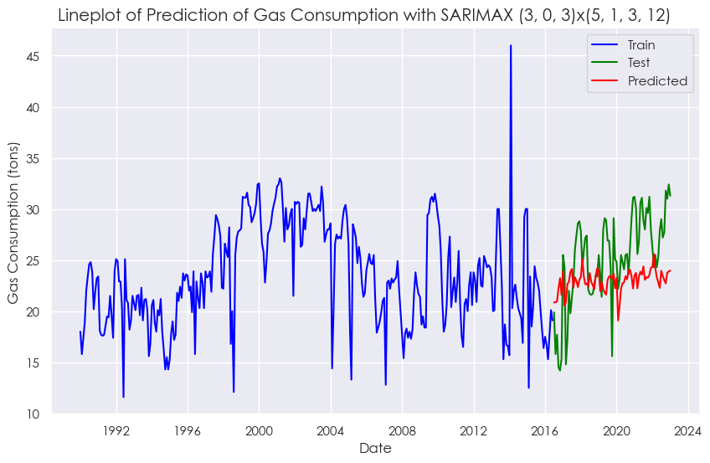
TIME SERIES FORECASTING
FINE TUNING
GAS CONSUMPTION
IMPROVEMENT MADE!

Slide 41


TIME SERIES FORECASTING
FINE TUNING
WATER CONSUMPTION
IMPROVEMENT MADE!

Slide 42

FORECAST FUTURE VALUES
TIME SERIES FORECASTING

Slide 43

CONCLUSION
In conclusion, time series models such as SARIMAX and Holt-Winters Exponential Smoothing were identified as the best models for the prediction and forecast of gas and water, and electricity respectively when compared to the test data to evaluate the strength of the model. Moreover, we can also see that the final models were able to forecast future values past the test data, however, the model still faces limitations which could possibly be overcome by having more data be collected for training and prediction. Overall, even though the models still made errors, significant improvements were still made from hyperparameter tuning and fine-tuning the models, and these models built would be a stepping stone to better and more accurate models in the future.

Slide 44


THANK
YOU!

